Slide 1

ROCKBUSTER STEALTH DATA ANALYSIS
By Maria Juliana Giglio Fernandes

Slide 2

Introduction
Rockbuster Stealth LLC is a movie rental company that used to have stores around the world. Facing stiff competition from streaming services such as Netflix and Amazon Prime.
The Rockbuster Stealth management team is planning to use its existing movie licenses to launch an online video rental service in order to stay competitive.

Slide 3

KEY QUESTIONS:
Which movies contributed the most/least to revenue gain?
Which countries are Rockbuster customer based in?
Where are the Revenue By Genre?
Where are customers with a high lifetime value based?

Slide 4
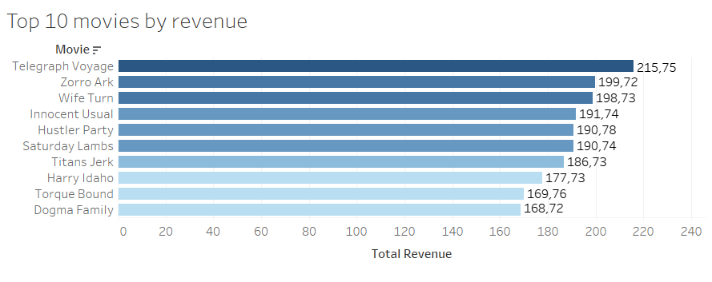

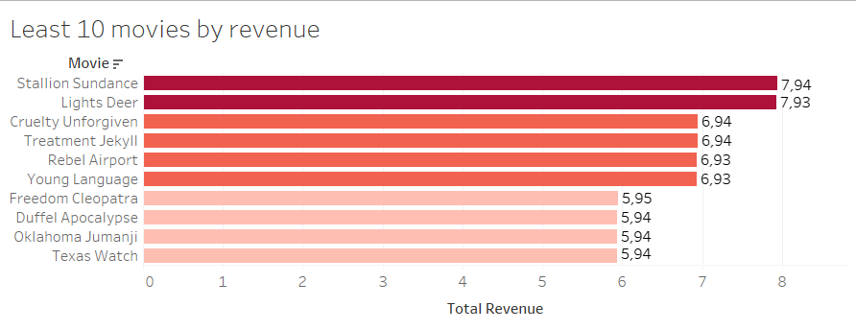
Which movies contributed the most/least to revenue gain?

Slide 5
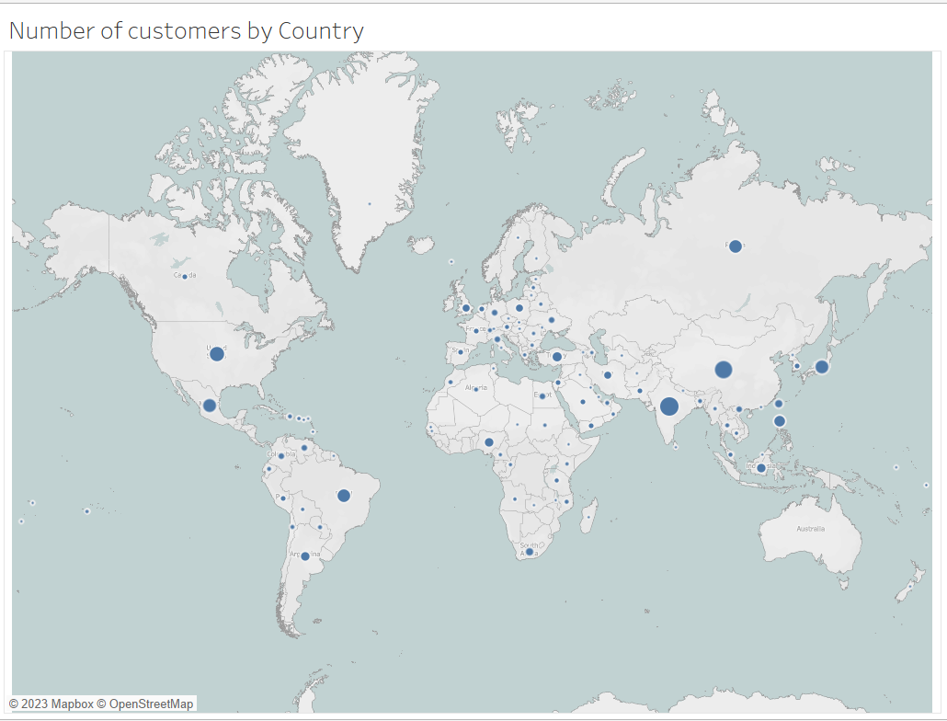
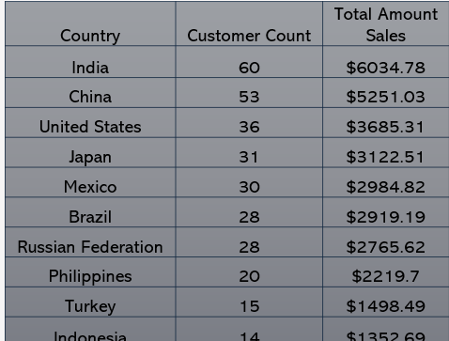
Which countries are Rockbuster customer based in?
India has the most RockBuster customers, and the highest revenue as well

Slide 6
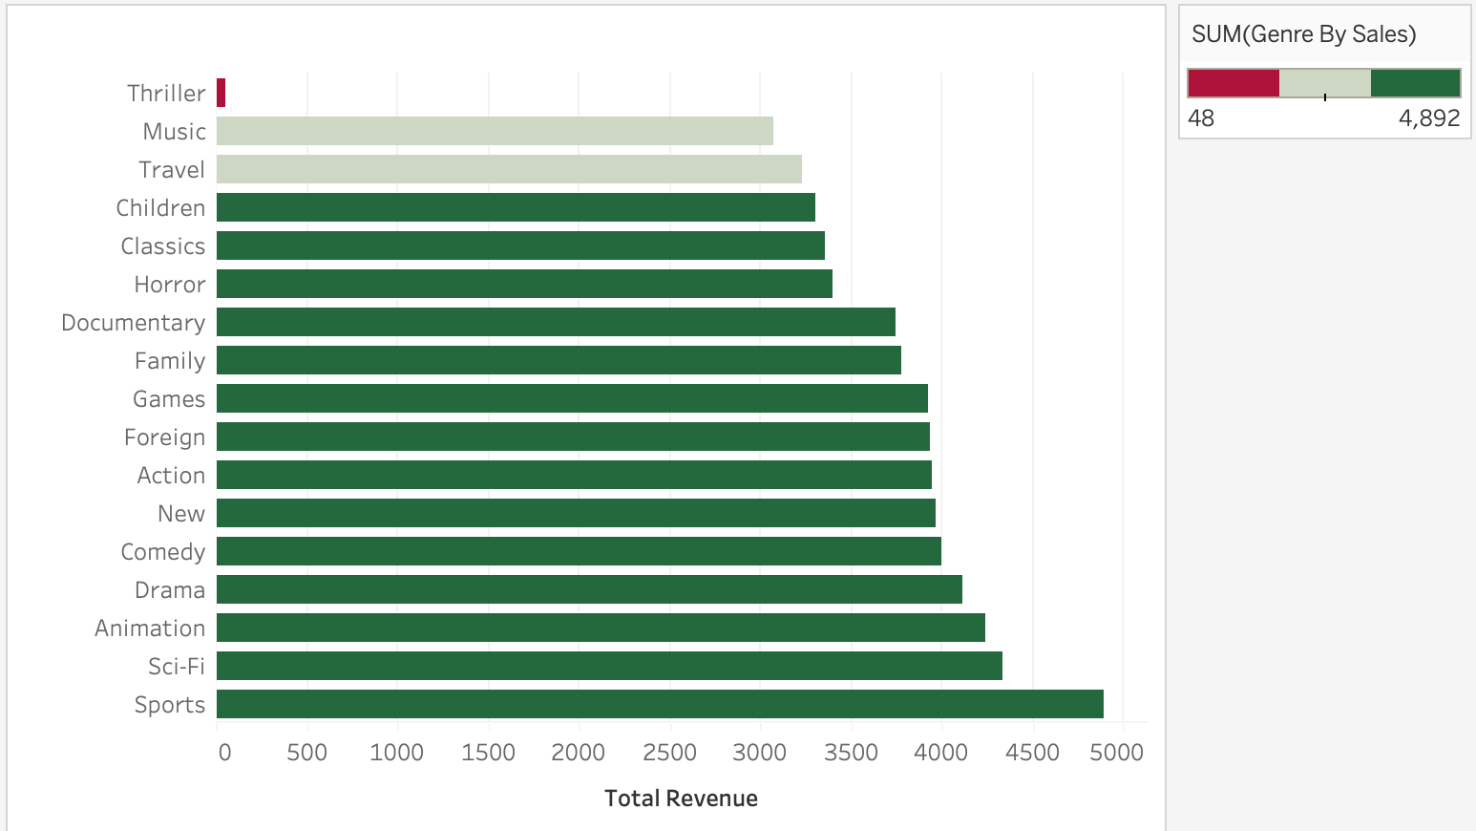

Where are the Revenue By Genre?
Sports is the highest grossing genre by far, and Thrillers are very far behind.

Slide 7
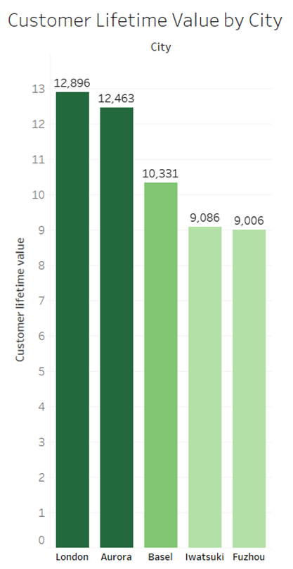
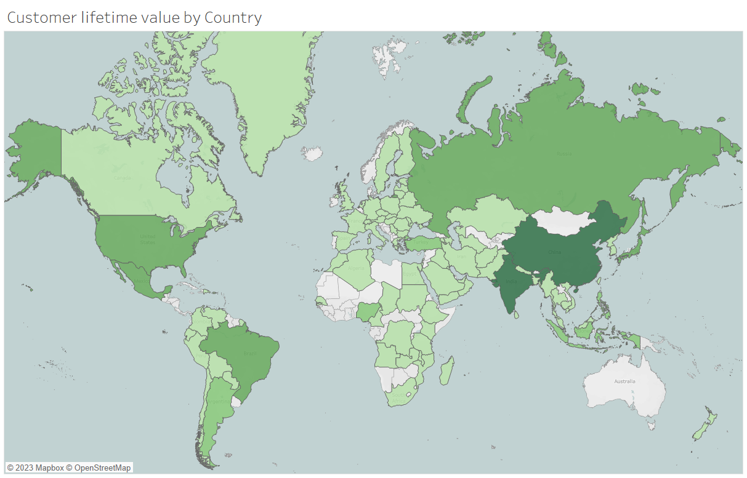
Where are customers with a high lifetime value based?

Slide 8

Recommendations
Increase your library across all genres.
I suggest rewarding their loyalty with discounts or special promotions.
I suggest consolidating Rockbuster presence in America and Asia and to plan a precise marketing strategy in other regions (such as Europe) to fight competitors

Slide 9

By Maria Juliana Giglio Fernandes
mg.mariagiglio@gmail.com

